Slide 1
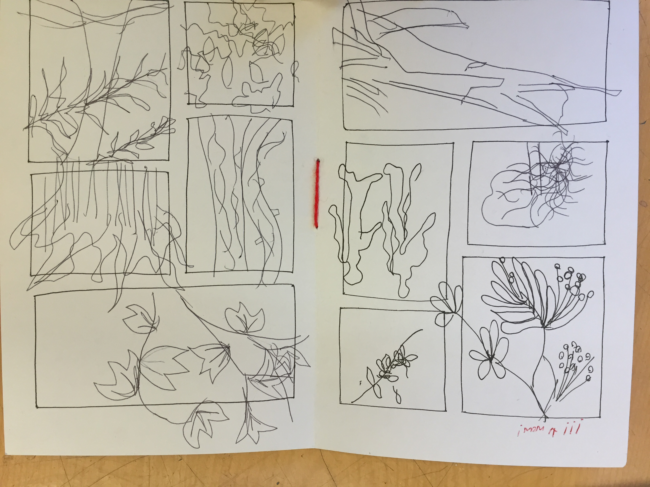
Freeing your Hand from your Eye
Using Blind Contour Drawing

Slide 2
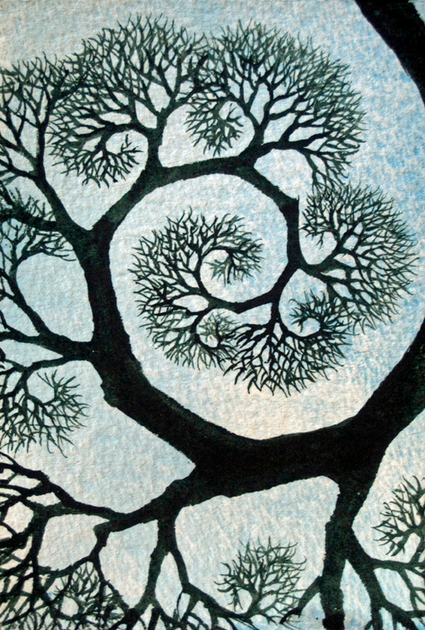
Overview of
Creative Work Flow:
Style Points/ Techniques from Me
Research Done by you (outside, drawing,
other info-gathering)
Development of Ideas in the Studio
Critique from Me and Peers
Self-reflection
Spiral Through Again at a higher level

Slide 3
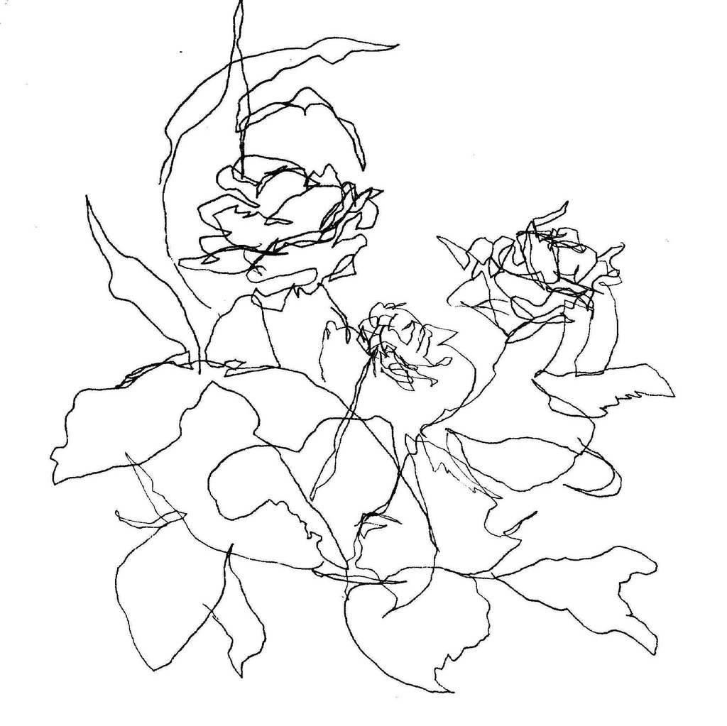
Blind Contour
45 Seconds to 3 minutes each
Large quantity of drawings will
prove how improved your drawing
can become! Drawing is not labor!
This style will warm you up and
Feel like a playful way to free your
Conscious thoughts about what to
Make art about!

Slide 4
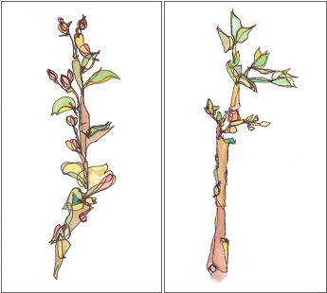
How to Do Blind Contour Drawing:
Use Space frames to Organize your page
DON’T LOOK AT THE PAPER!
Marks should resemble “groping” for a likeness to the subject you choose
BOUNCE, SKIP, DANGLE, ROLL, AND PICK UP YOUR HAND OFTEN TO RELOCATE NEW DRAWING INFORMATION.
The more abstract they become, the more your lines and marks resemble the uninhibited and fearless artist in YOU!
Complete 12 pages of Blind Contour using PEN!
Blind contour with ink and watercolor

Slide 5

Blind Contour Drawing Day 1
Inside:
Check-in
Bind Books
Add Space Frames
Outside:
Walking
Blind Contour drawing,
continued...

Slide 6
Blind Contour Drawing Day 2
Inside:
Check-in
Find a Buddy
Get your Pen and Grey Sketchbook
Finish adding Frames if needed
Outside:
Walking
Final Blind Contour drawing day
Completed Books due Today

