Slide 1
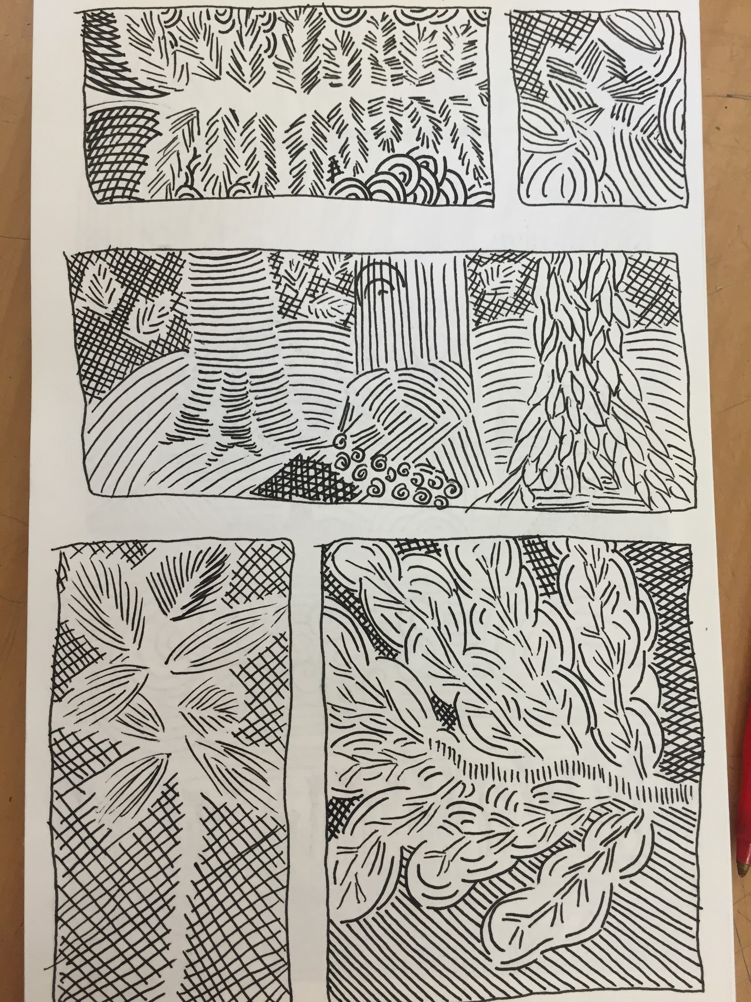

Drawing With
Optic Fields:
Describing Forms with lines, but NO contours!

Slide 2
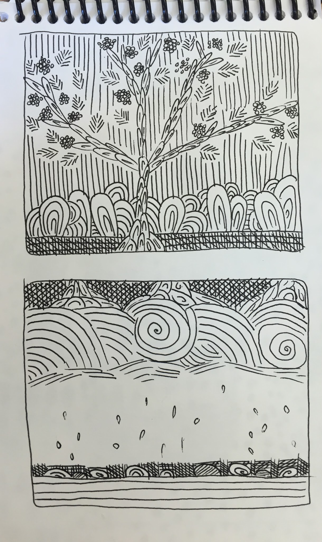
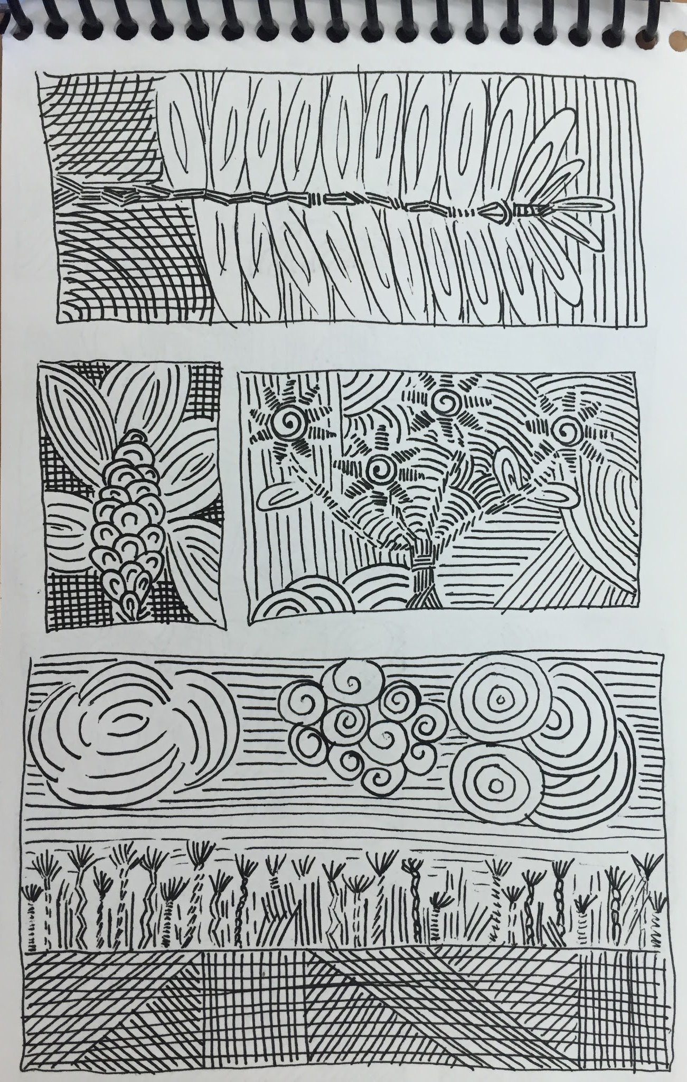
Using Fields We Create
Optic Spaces that Charge the Eye!

Slide 3
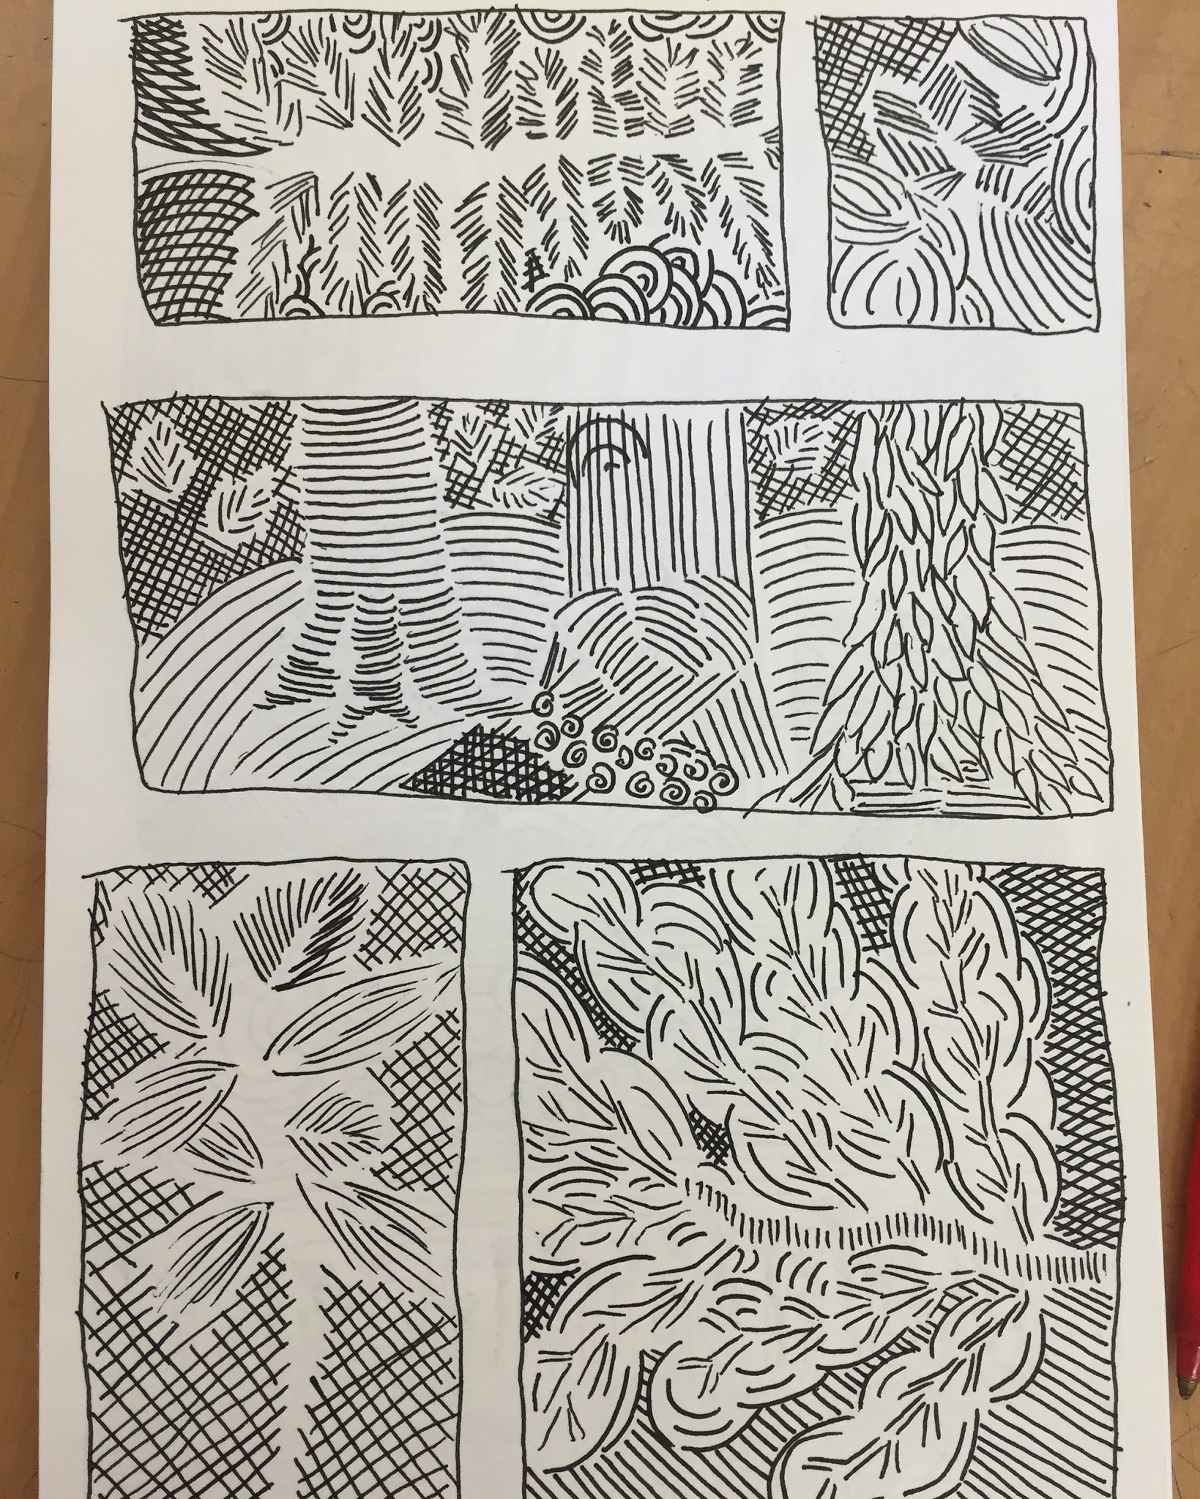
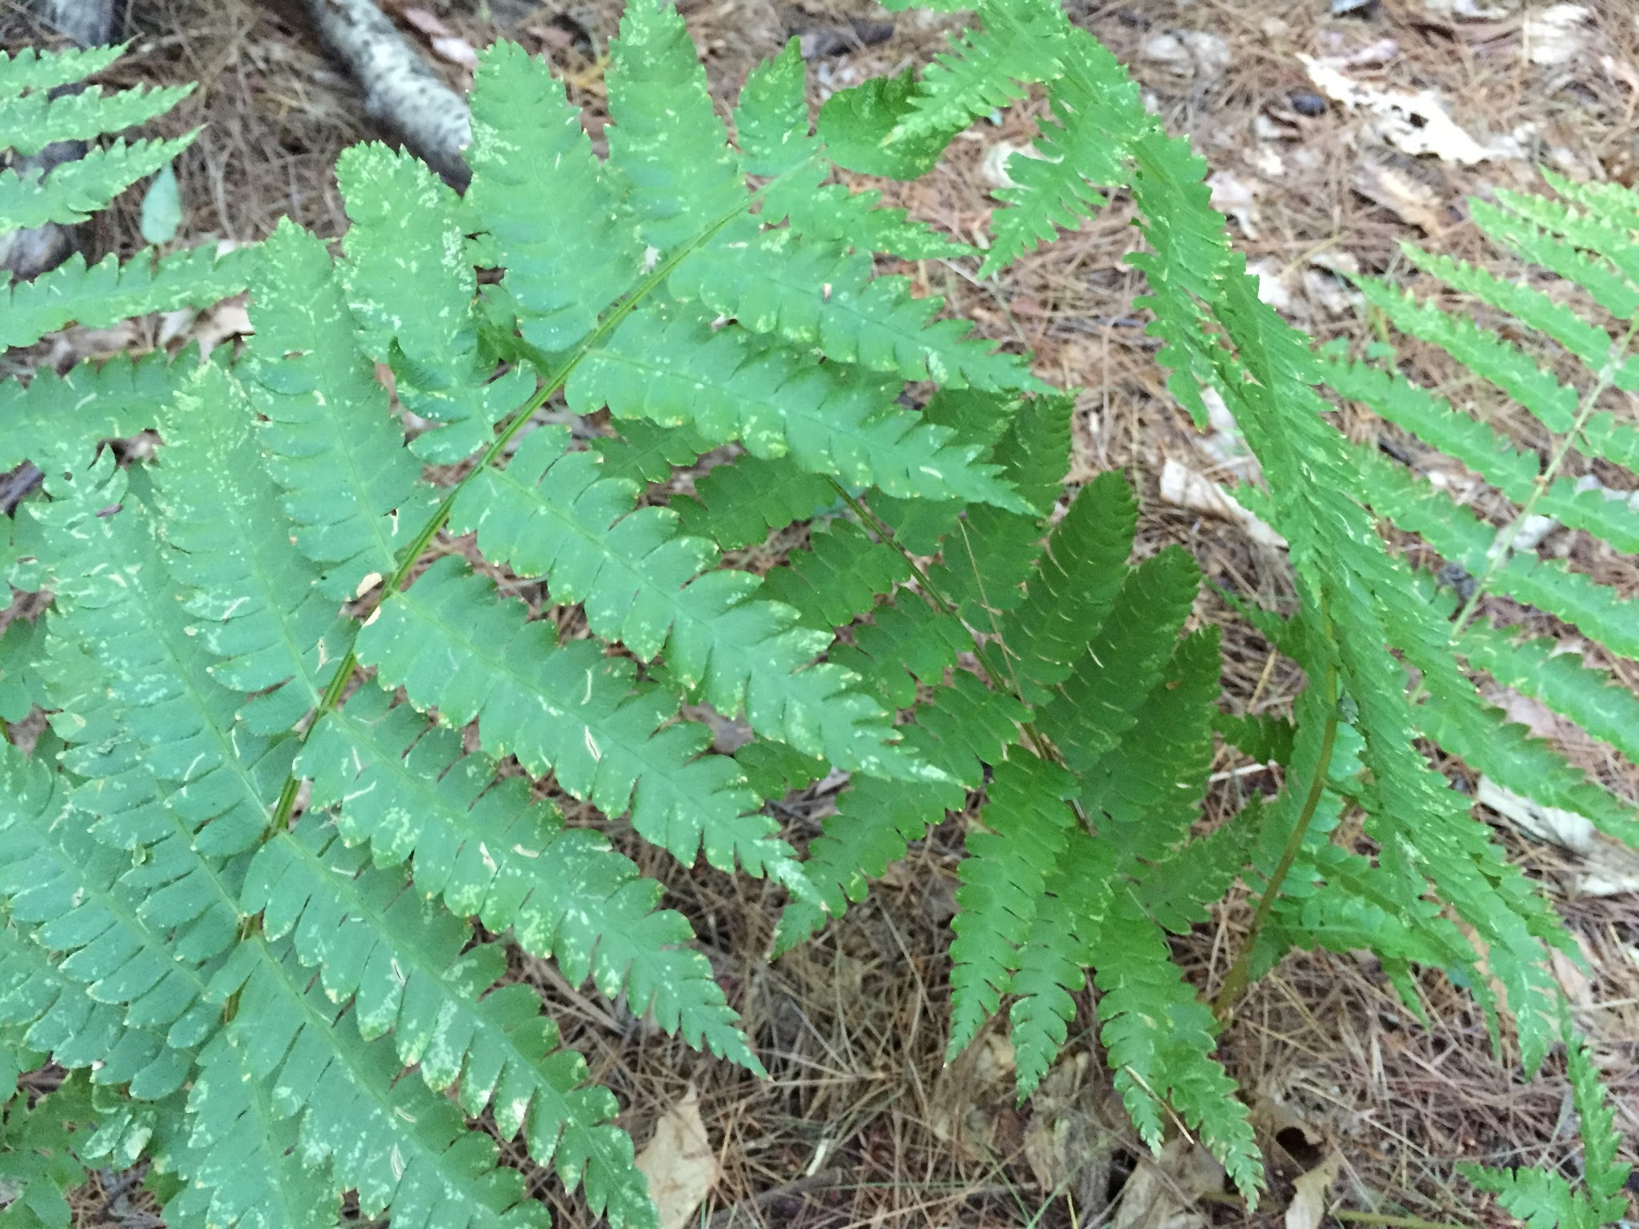
How can we use invention to translate through drawing?

Slide 4
In each “Field” the line changes to create bristling optic effects

Slide 5
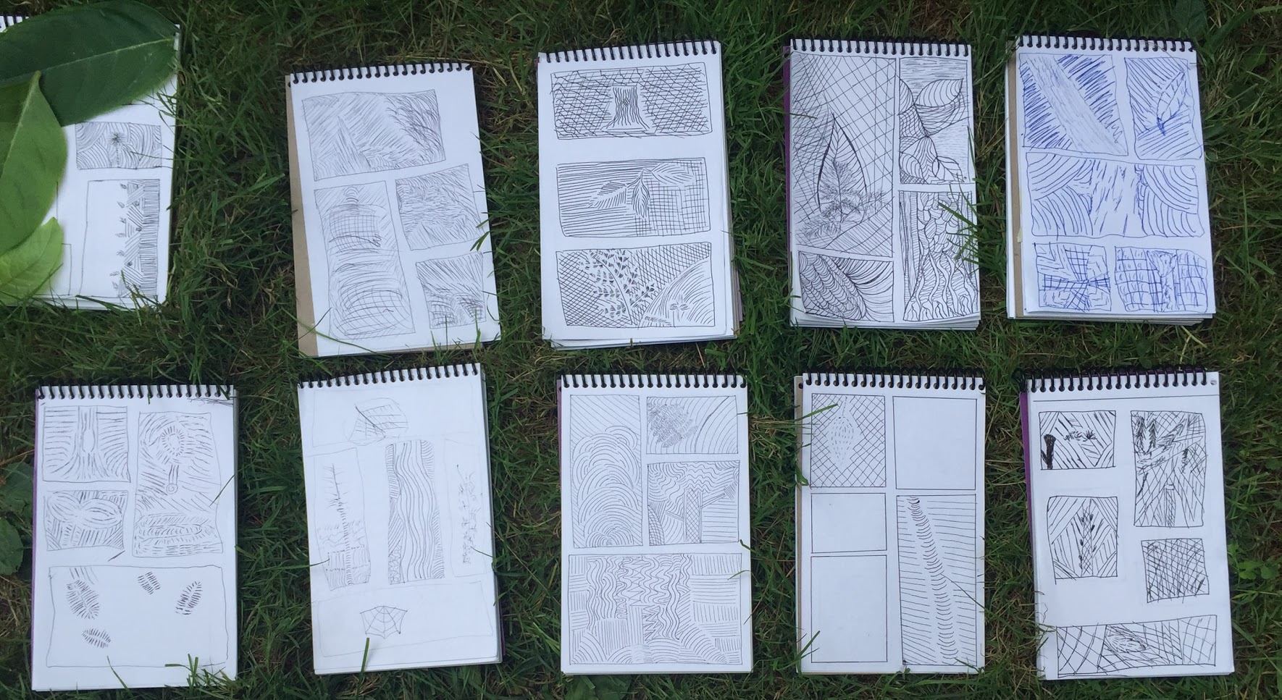

Slide 6

Let’s Practice

